Slide 1
Load, don’t code: ONLINE ANALYSIS THAT ENDS IN YOUR FIGURE
BRIAN mapes, RSMAS
lunch bytes 2018-11-09

Slide 2
Free beer offered. why?
Archive center. NASA example
Bureaucratic – but big, organized, responsive, professional, desirous of users
First duty is data custody, then distribution
If well led, may be working on post-shopping-cart portals (with some analytics)
Research center serving its own scientists, oh and the world.
Willing to make analysis choices (like data = climatology* + anomaly)
NOAA PSD, LDEO library’s Ingrid
Brilliant individuals showing off wizardry
Lots of analysis! Ingrid, Climate Explorer (Geert Jan von Oldenborgh)

Slide 3
Four specific sites
Giovanni, now federated across NASA multiple data centers. Part of GES-DISC tools https://disc.gsfc.nasa.gov, whose User Committee I’d be happy to channel your comments to... https://giovanni.gsfc.nasa.gov/giovanni.
NOAA PSD, my former institution (climate diagnostics center), https://www.esrl.noaa.gov/psd/cgi-bin/data/getpage.pl.
Climate Explorer at KNMI (Netherlands). High powered statistics on lots of data. https://climexp.knmi.nl/start.cgi
Ingrid at LDEO, http://iridl.ldeo.columbia.edu.

Slide 4
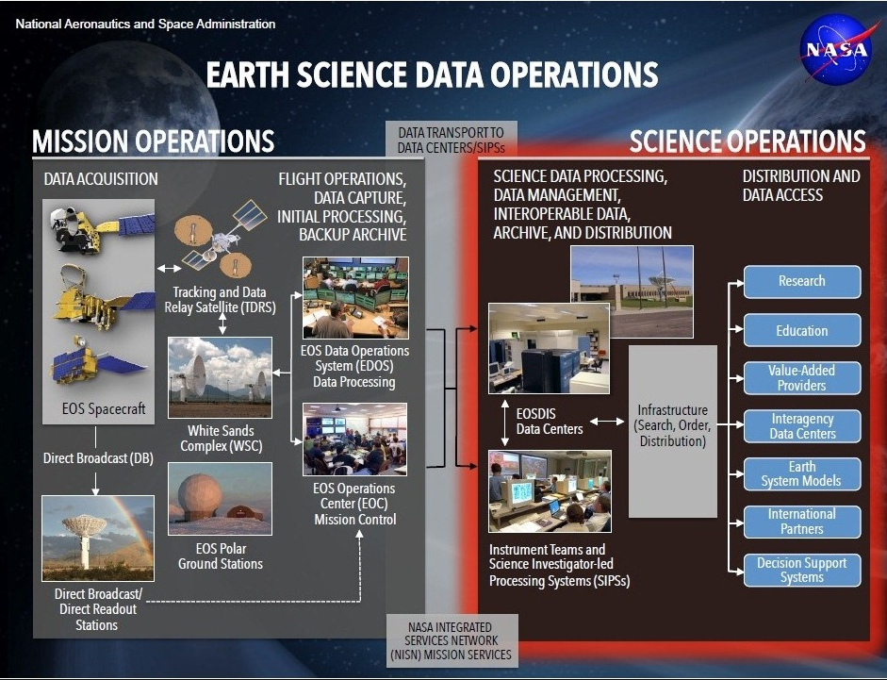
EOSDIS
Earth Observing System Data and Information System (EOSDIS)

Slide 5
ESDIS
ESDIS Project manages the science systems of the Earth Observing System Data and Information System
(EOSDIS)

Slide 6
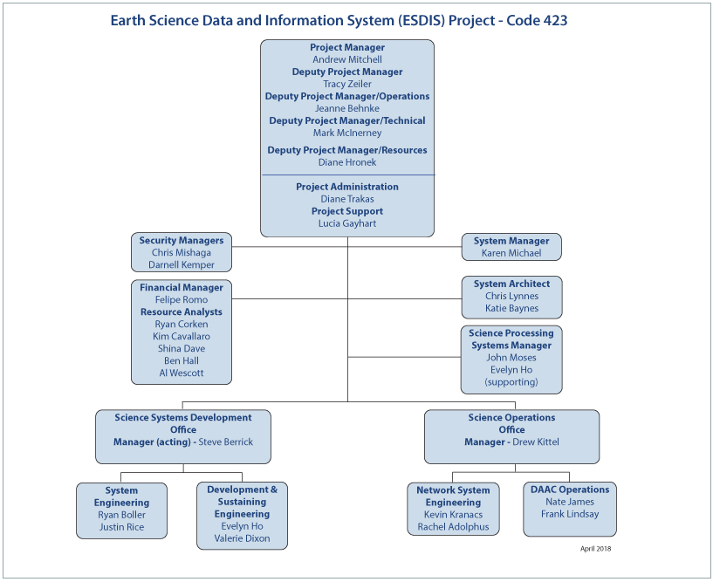
ESDIS
ESDIS Project manages the science systems of the Earth Observing System Data and Information System
(EOSDIS)

Slide 7
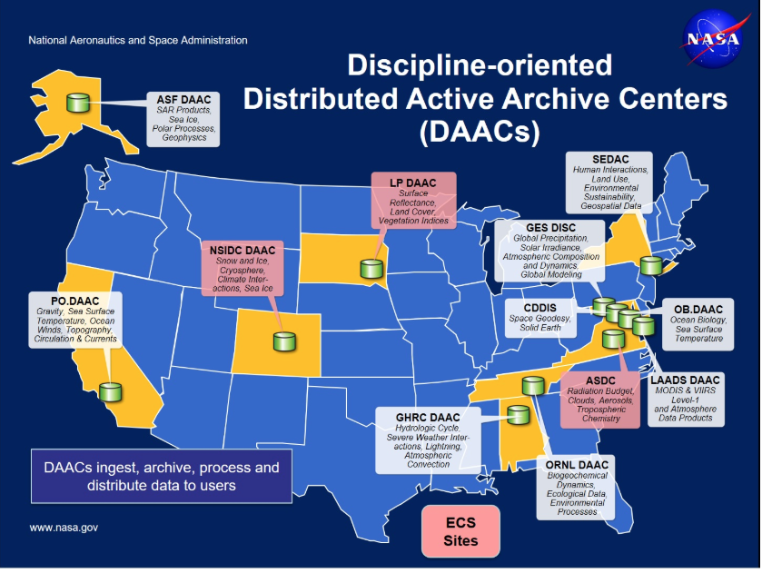
DAAC ss
GES DISC is the biggest, and leading.
Federation is the goal so users don’t see these distinctions

Slide 8
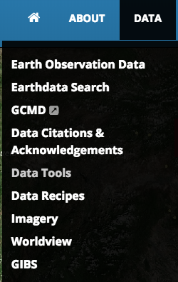
https://earthdata.nasa.gov/
Since 2017, authenticated. It sucks, downloading data is harder.
imagery still unauthenticated…
Most popular is imagery
can lead to download now

Slide 9
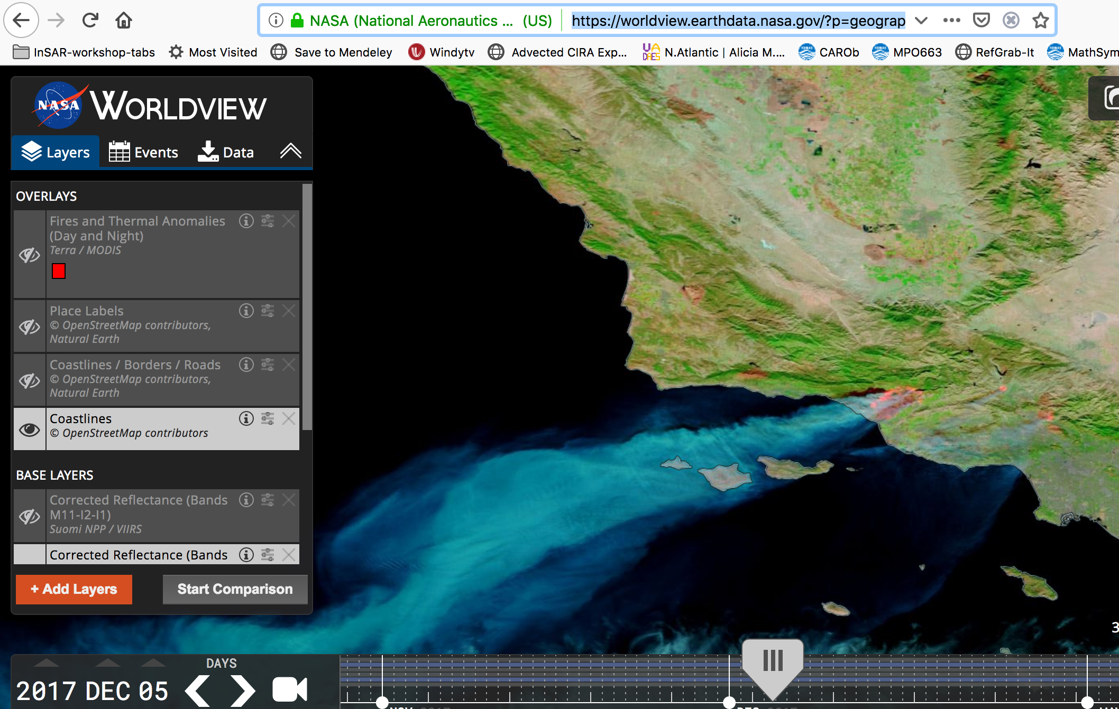

Slide 10
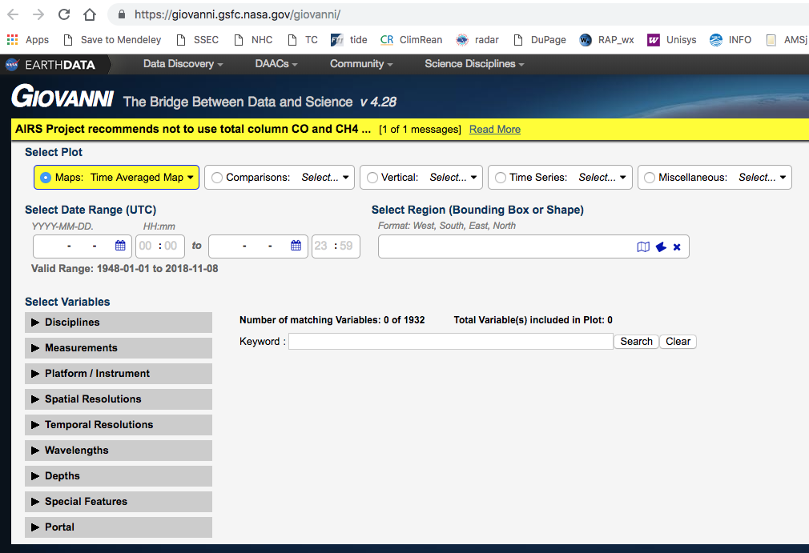
A bit tedious, but the results go into a URL you can learn to “program”
https://giovanni.gsfc.nasa.gov/giovanni/#service=TmAvMp&starttime=2000-01-01T00:00:00Z&endtime=2000-03-31T23:59:59Z&data=NLDAS_FORA0125_MA_002_pressfc%2CSWDB_L3M05_004_aerosol_optical_thickness_550_land_ocean&variableFacets=dataFieldDiscipline%3AAerosols%3B

Slide 11
data archivers and offerers are not quite scientist oriented sometimes
To the extent we study specific place and time, we need all-data context, not just the abs. values.
Is it anomalous? how significant?
They squirm at making any arbitrary choices
even a mean/stdev over arbitrary set of years

Slide 12
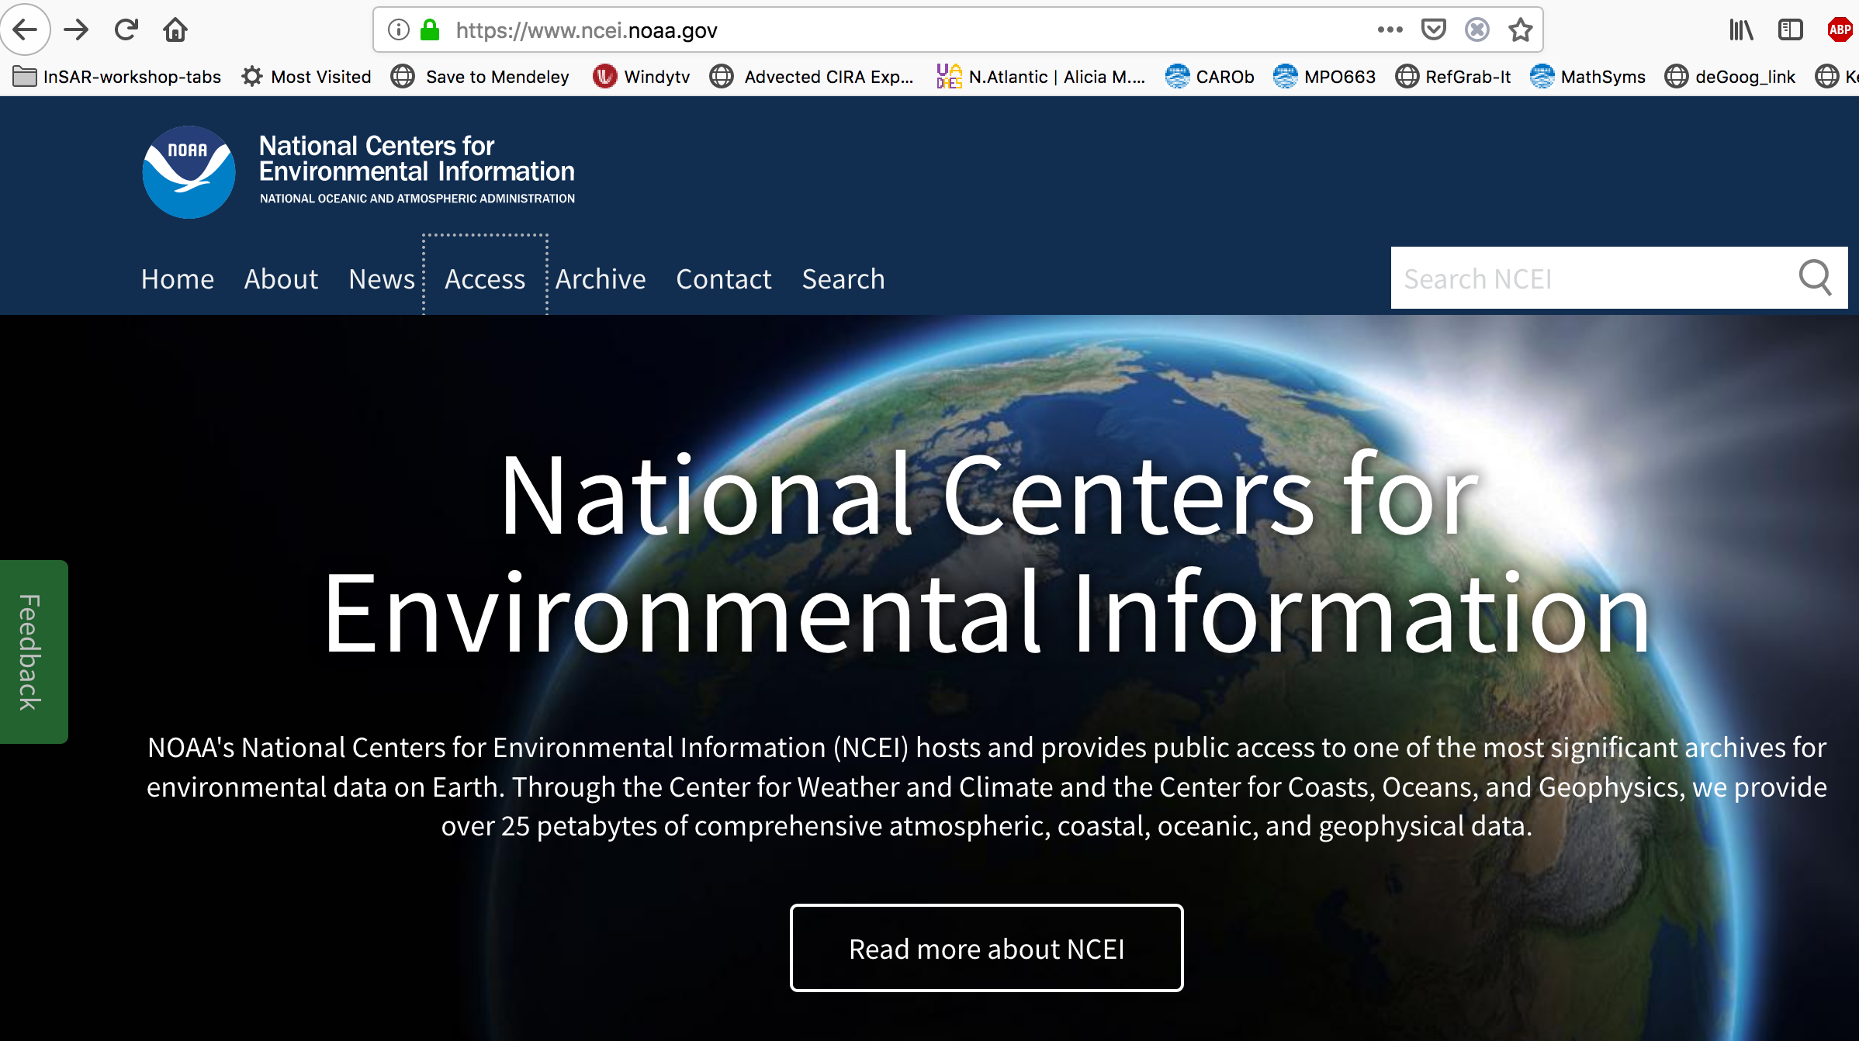
Other agency– still download oriented
ncei (formerly ncdc)

Slide 13
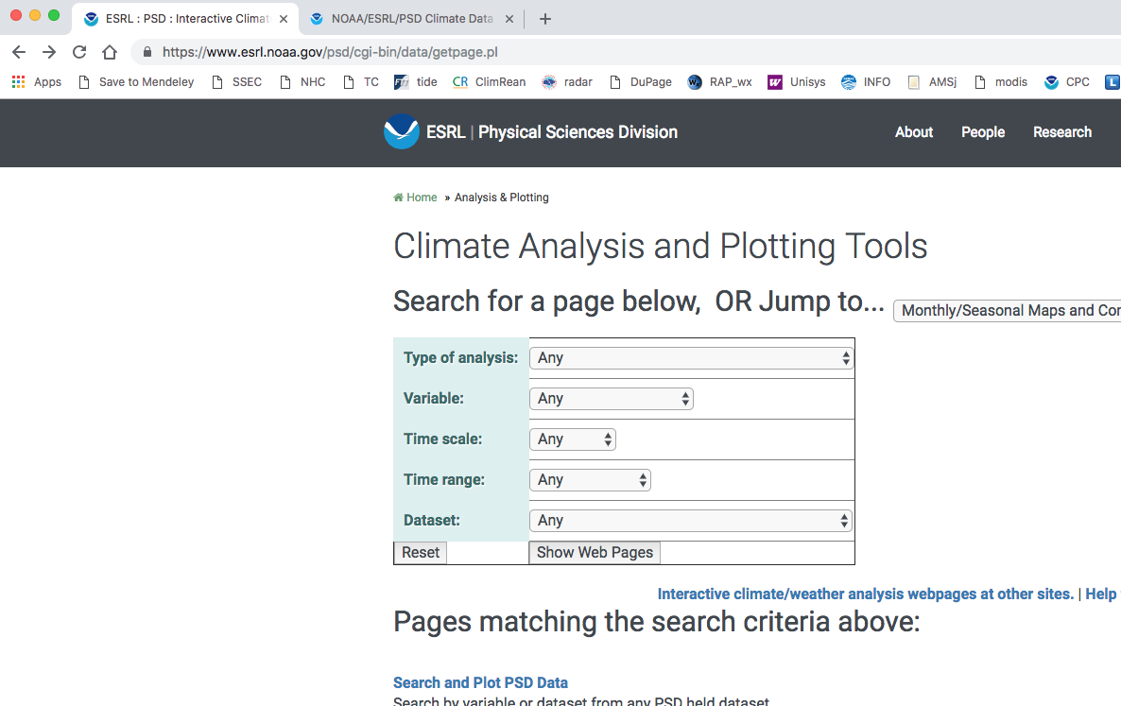
NOAA PSD: formerly climate diagnostics center

Slide 14
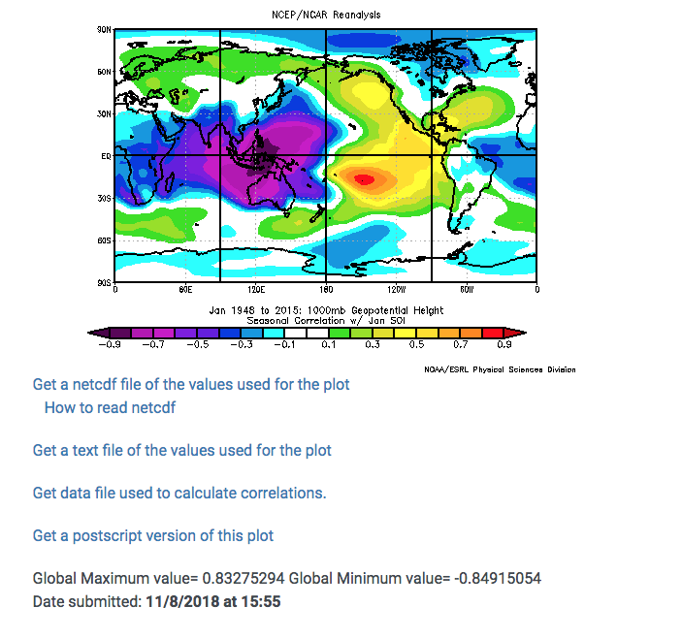
Again the URL is the code
https://www.esrl.noaa.gov/psd/cgi-bin/data/correlation/corr.test1.pl?iregr=1&var=Geopotential+Height&level=1000mb&mon1=1&mon2=1&iy%5B1%5D=&iy%5B2%5D=&ilead=0&ilag=0&type=1&timefile=&customtitle=&labelc=Color&labels=Shaded&cint=&lowr=&highr=&scale=&switch=0&proj=ALL&xlat1=&xlat2=&xlon1=&xlon2=&custproj=Cylindrical+Equidistant&level1=1000mb&level2=10mb&Submit=Create+Plot

Slide 15
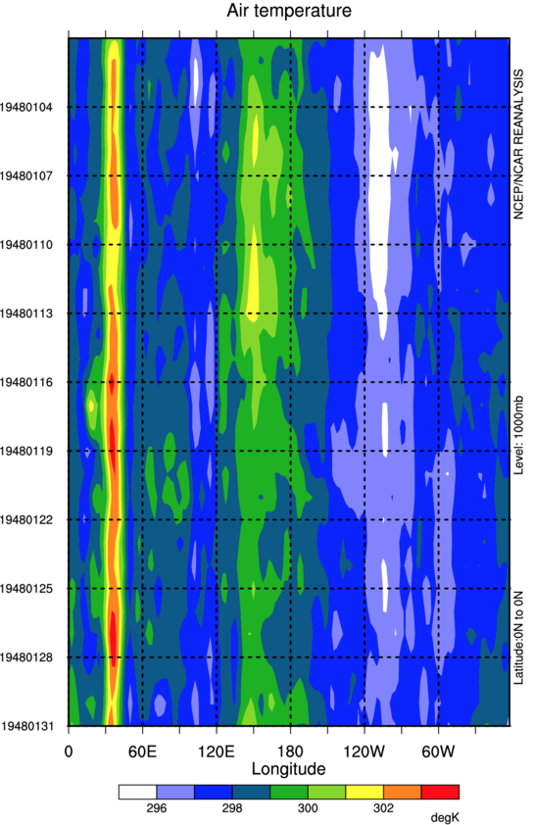
Prepopulated with defaults, nice touch HAS anomaly (relative to climo, labeled properly)
https://www.esrl.noaa.gov/psd/map/time_plot/
work from there…

Slide 16
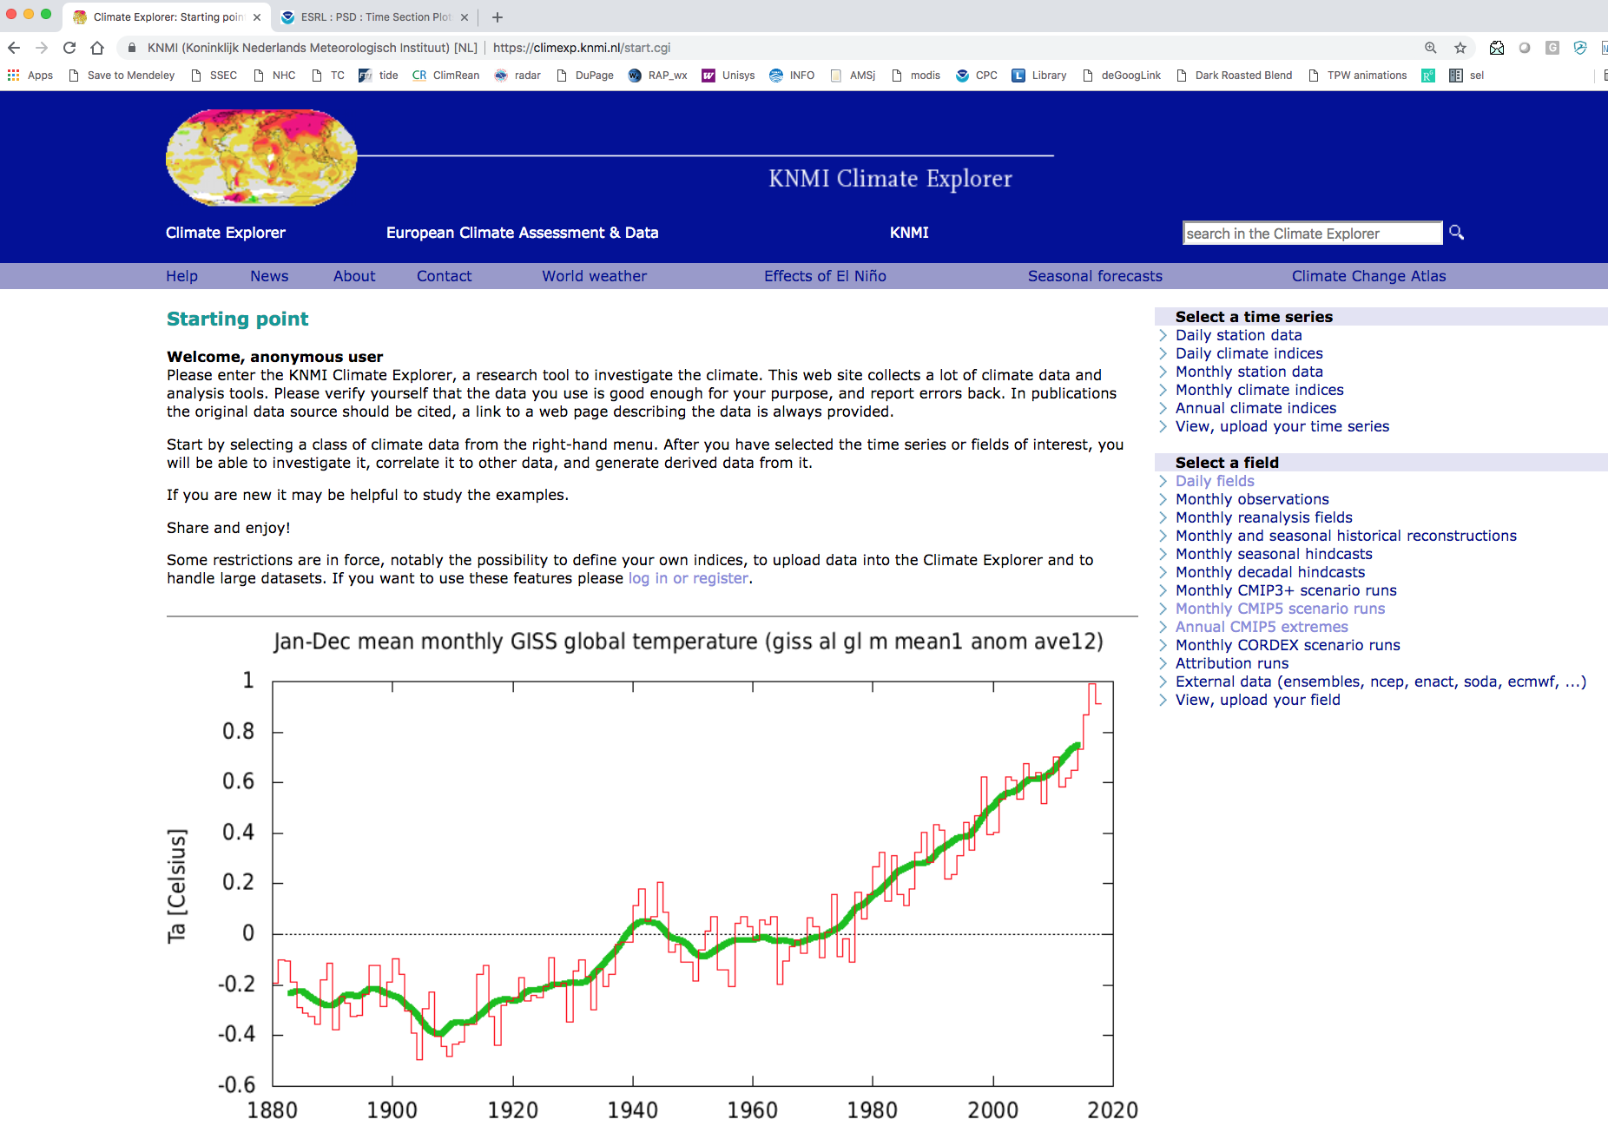
Even more climate analytics: climexp.knmi.nl has all the coherence of a personal project…
Lets do a
time series example

Slide 17
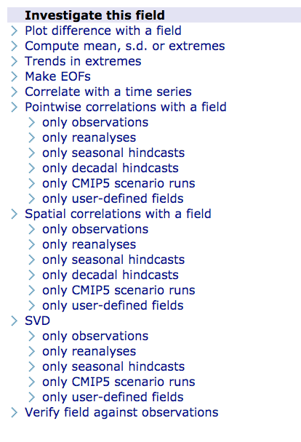
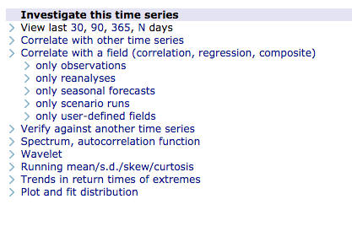

Slide 18
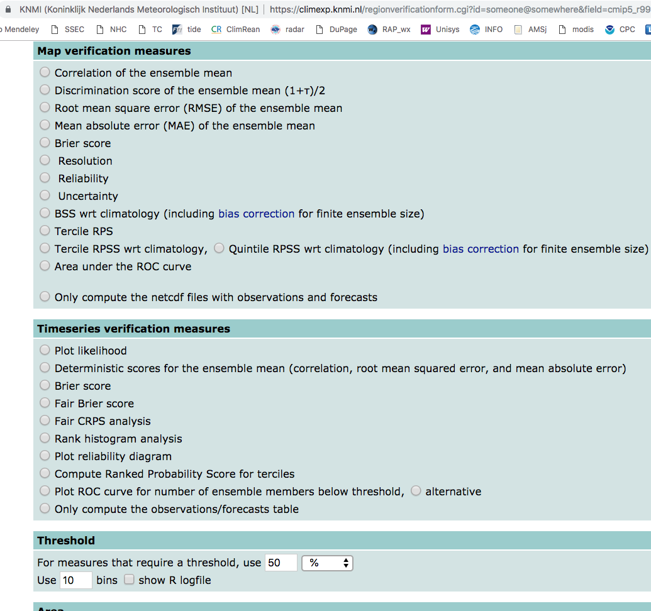

Slide 19
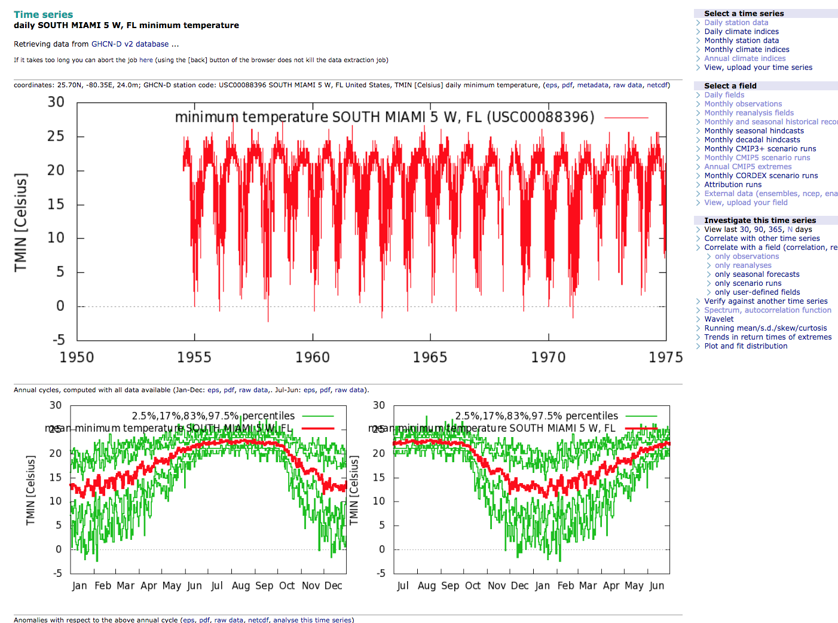
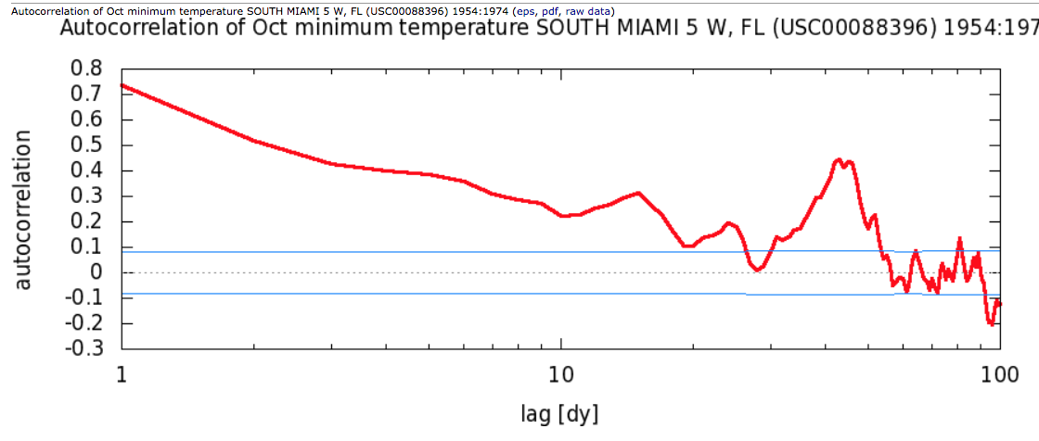

Slide 20
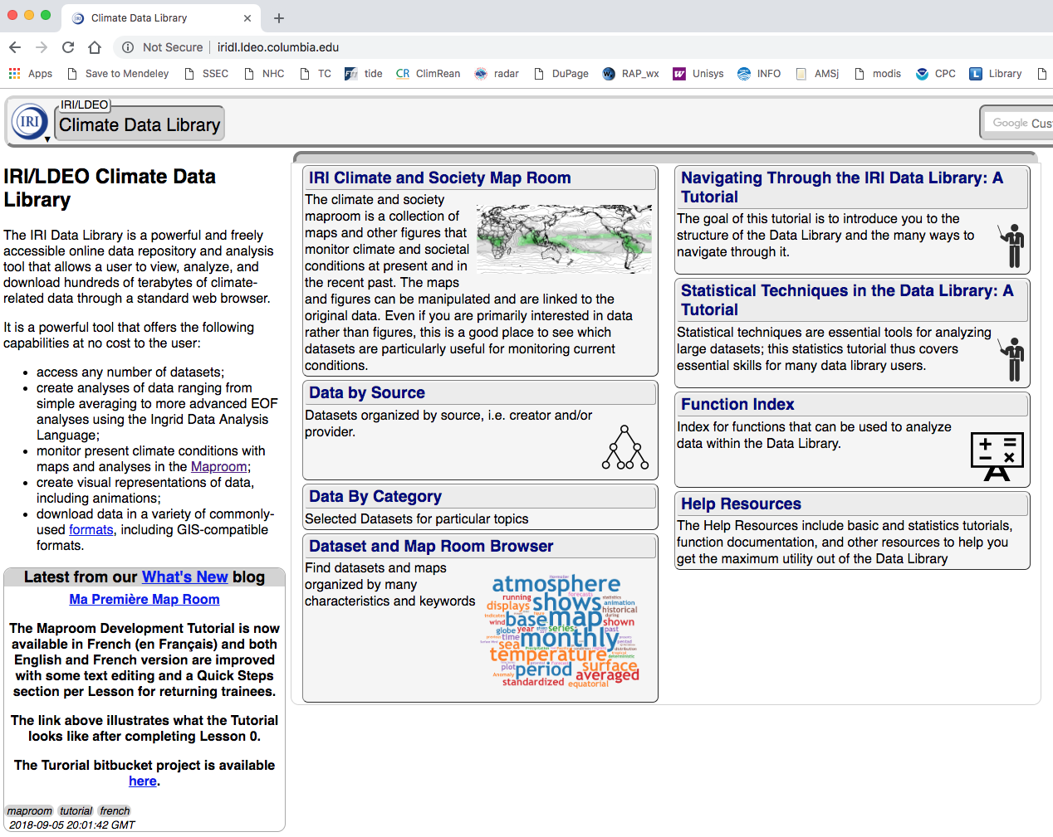
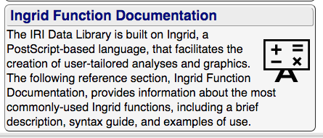
a little more professional at the web face but still a quirky thing

Slide 21
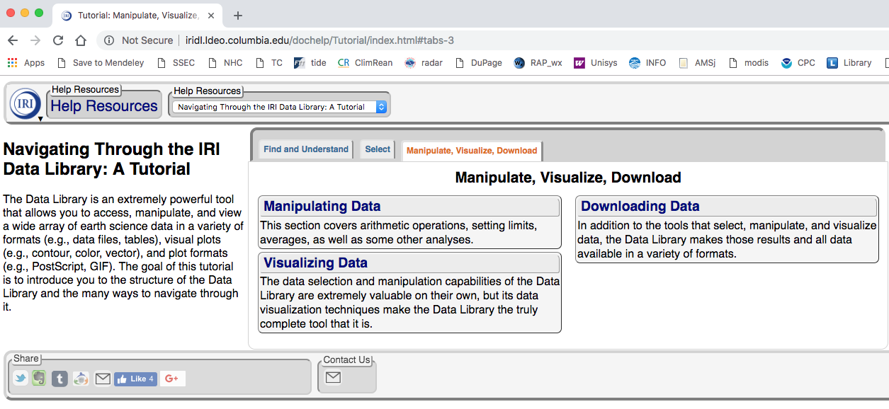

Slide 22
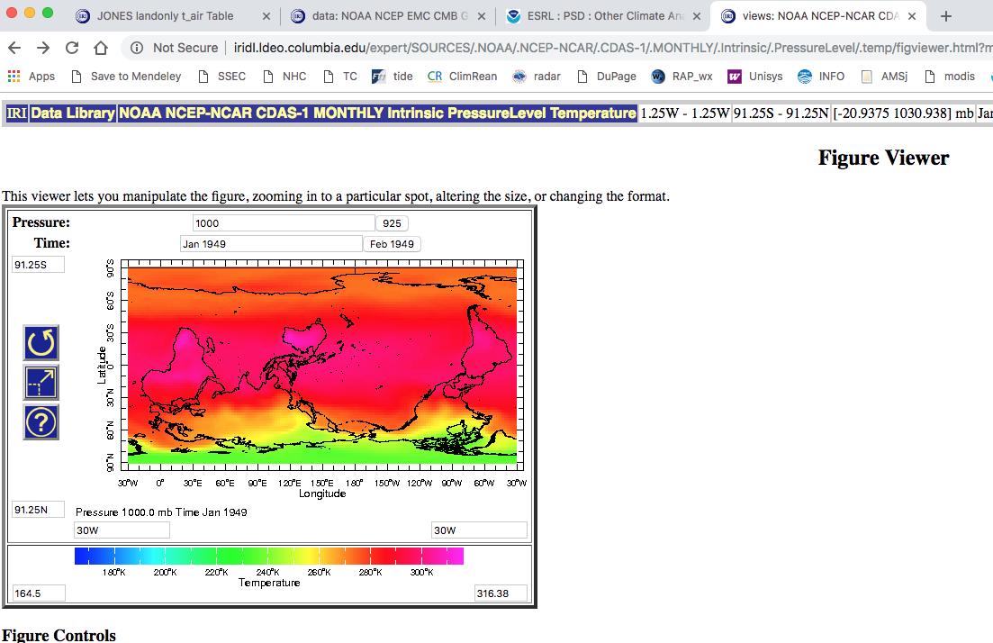
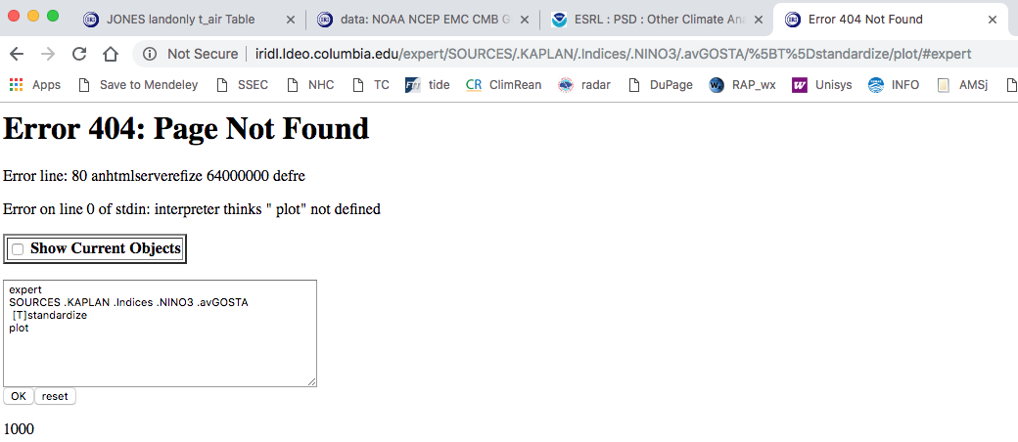
What th ?? teddy liked it
not me

Slide 23
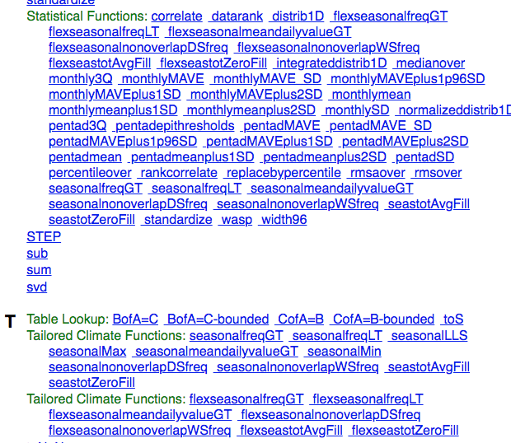
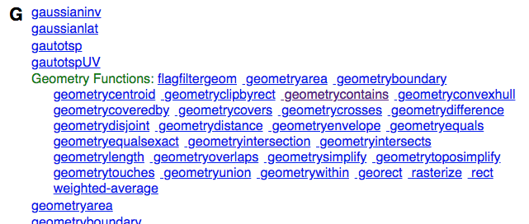
basically a front face to a new coding language

Slide 24
free analytics and plotting! as free as your time…
but webform tedium must be weighed against coding…
and safer (tested)
and sometimes replicable (URL)
with URL editing as a form of automation
for typical cases (correlation of ENSO on some climate field), it is CRAZY to download data and write a code to read it, remove annual cycle, perform regressions, display results – unless you want to learn how to
For something new, YMMV

Slide 25
others
know some?
a list is here
https://www.esrl.noaa.gov/psd/data/gridded/web_tools.noncdc.html

